Slide 1

2022 Fall Coding Camp
Running and collecting DFT Features
Liliana C. Gallegos – Nov 9 2022

Slide 2

Types of Features
Structural descriptors – %Buried Volume, Shell BV, Sterimol (e.g., Bmin, Bmax, L), Surface area, Bond lengths, Angles.
Property descriptors – Atomic charges, NMR chemical shifts, Molecular orbitals (e.g., HOMO/LUMO), Fukui indices (e.g., f+ for electrophilicity and f- for nucleophilicity)
Functional descriptors – reaction thermochemistry (e.g., amine protonation/deprotonation)
How to run and collect these DFT Features?

Slide 3
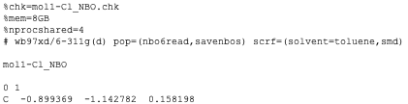
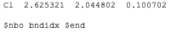
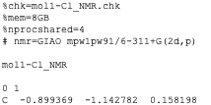
How to run DFT feature calculations?
Gaussian Inputs
NBO calculations – Natural Atomic Orbital and Natural Bond Orbital analysis: population analysis for characterizing "bond" and "electron density" in computed molecules. # pop=(nbo6read,savebos)
Wiberg Bond Index analysis: matrix of all bond orders between two covalent bonded atoms. Include at end of input file (after gen/genecp text): $nbo bndidx $end
GIAO NMR calculations – Gauge-Independent Atomic Orbital method to obtain NMR tensor values and chemical shifts. Using recommended level of theory. # nmr=GIA mPW1PW91/6-311+G(2d,p)

Slide 4
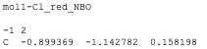
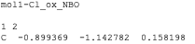
How to run DFT feature calculations?
Gaussian Inputs
Fukui indices – electrophilicity and nucleophilicity analysis. Describes which atoms in a molecule have a larger tendency to either loose or accept an electron. Requires 3 NBO files: (i) original: 0 1 (ii) reduced (gains an electron so -1 charge with 2 multiplicity): -1 2 (iii) oxidized (looses an electron so +1 charge with 2 multiplicity): 1 2
Calculations require less memory and number of processors… can be quick calculations.

Slide 5


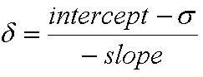
How to collect DFT feature calculations?
From Gaussian NBO and GIAO outputs
Python scripts to parse through data for DFT computed calculations.
Today, will be a DISCO party demo… ☺
NBO analyzer
Bond indices for specified bond(s) Great for NBO of IRC calcs.
cDFT
f+ Fukui electrophilicity
DISCO
Atomic charges
NMR tensor values
f- Fukui nucleophilicity
Atomic charges For all atoms at once.
HOMO/LUMO values
Bond distances
NMR chemical shifts
https://github.com/Liliana-Gallegos/DISCO http://cheshirenmr.info/ScalingFactors.htm

Slide 6
DISCO demo
Using the Terminal and Jupyter Notebook
GitHub: Liliana-Gallegos/DISCO
Cheshire NMR website developed by the Tantillo group for scaling factors: http://cheshirenmr.info/ScalingFactors.htm
Tutorial includes: 1. NBO and NMR outputs to collect features. Files can be found in disco github and hklem/computing-basics. 2. CSV file of molecule names, SMILE strings, and specified bond of interest. 3. Jupyter Notebook tutorial for running in a high-throughput workflow.

